Slide 1
CSE 601: Distributed Systems
Toukir Ahammed

Slide 2
Communication
Interprocess communication is at the heart of all distributed systems
Communication in distributed systems
ways that processes on different machines can exchange information
Two widely used models for communication:
Remote Procedure Call (RPC), and
Message-Oriented Middleware (MOM)

Slide 3
Middleware
Middleware is invented to provide common services and protocols that can be used by many different applications
A rich set of communication protocols
(Un)marshaling of data, necessary for integrated systems
Naming protocols, to allow easy sharing of resources
Security protocols for secure communication
Scaling mechanisms, such as for replication and caching
Middleware can offer various alternatives in communication to applications
Middleware can be viewed as an additional service in client-server computing

Slide 4
Middleware
Consider an e-mail system, the core of the mail delivery system can be seen as a middleware communication service.
Each host runs a user agent allowing users to compose, send, and receive e-mail.
A sending user agent passes such mail to the mail delivery system, expecting it, in turn, to eventually deliver the mail to the intended recipient.
Likewise, the user agent at the receiver’s side connects to the mail delivery system to see whether any mail has come in. If so, the messages are transferred to the user agent so that they can be read by the user.

Slide 5
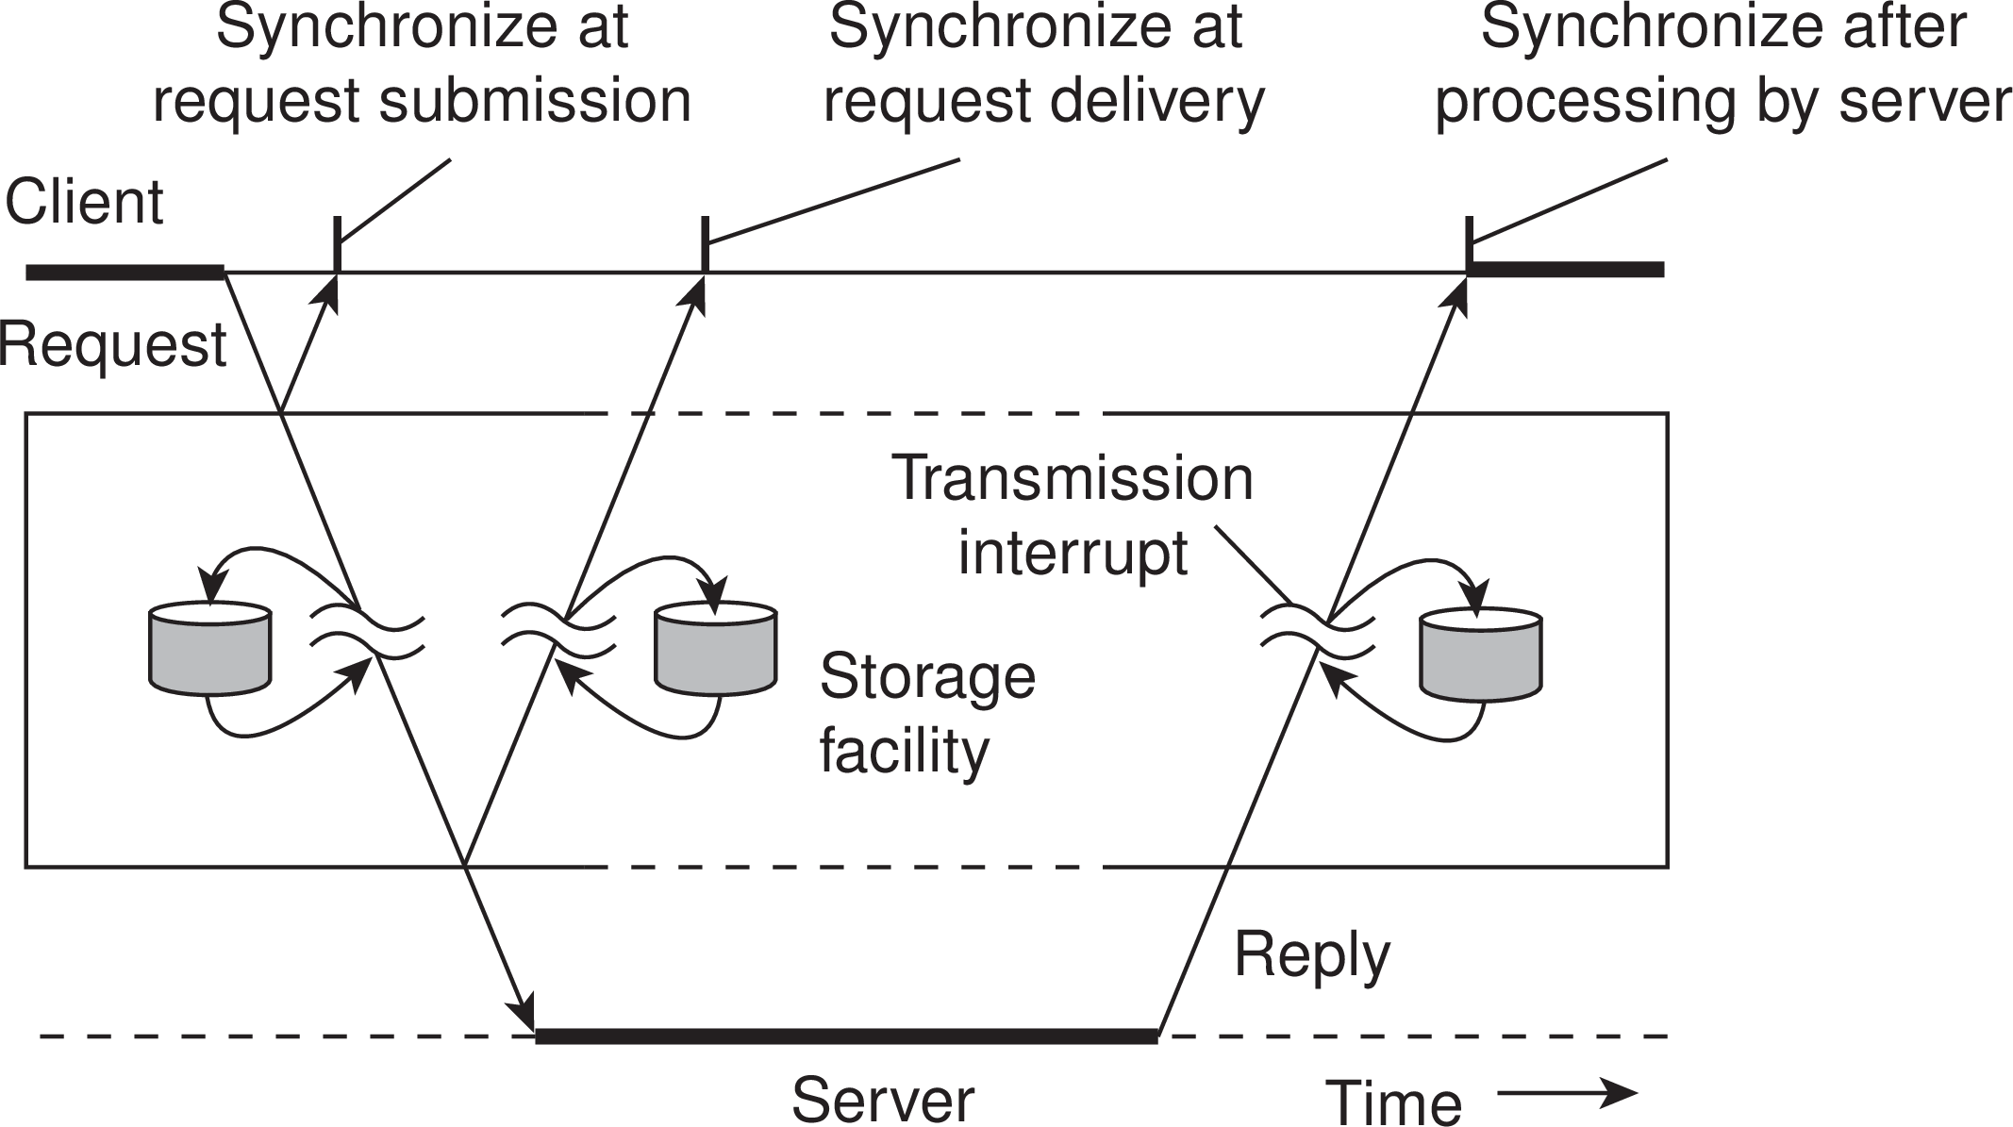
Types of Communication
Transient
vs
Persistent
Asynchronous
vs
synchronous

Slide 6
Persistent Communication
A message that has been submitted for transmission is stored by the communication middleware as long as it takes to deliver it to the receiver.
The middleware will store the message at one or several of the storage facilities
As a consequence, it is not necessary for the sending application to continue execution after submitting the message
Likewise, the receiving application need not be executing when the message is submitted.
An e-mail system is a typical example in which communication is persistent.

Slide 7
Transient Communication
A message is stored by the communication system only as long as the sending and receiving application are executing
If the middleware cannot deliver a message due to a transmission interrupt, or because the recipient is currently not active, it will simply be discarded
All transport-level communication services offer only transient communication
If a router cannot deliver a message to the next one or the destination host, it will simply drop the message.

Slide 8
Asynchronous Communication
A sender continues immediately after it has submitted its message for transmission
This means that the message is (temporarily) stored immediately by the middleware upon submission

Slide 9
Synchronous Communication
A sender is blocked until its request is known to be accepted
There are essentially three points where synchronization can take place
until the middleware notifies that it will take over transmission of the request
until its request has been delivered to the intended recipient
until its request has been fully processed, that is, up to the time that the recipient returns a response

Slide 10
Types of Communication
Various combinations of persistence and synchronization occur in practice.
Popular ones are persistence in combination with synchronization at request submission, which is a common scheme for many message-queuing systems.
Likewise, transient communication with synchronization after the request has been fully processed is also widely used. This scheme corresponds with remote procedure calls.

Slide 11
Remote Procedure Call
When a process on a machine A calls a procedure on a machine B, the calling process on A is suspended, and execution of the called procedure takes place on B.
Information can be transported from the caller to the callee in the parameters and can come back in the procedure result.
No message passing at all is visible to the programmer. This method is known as remote procedure call, or often just RPC.

Slide 12
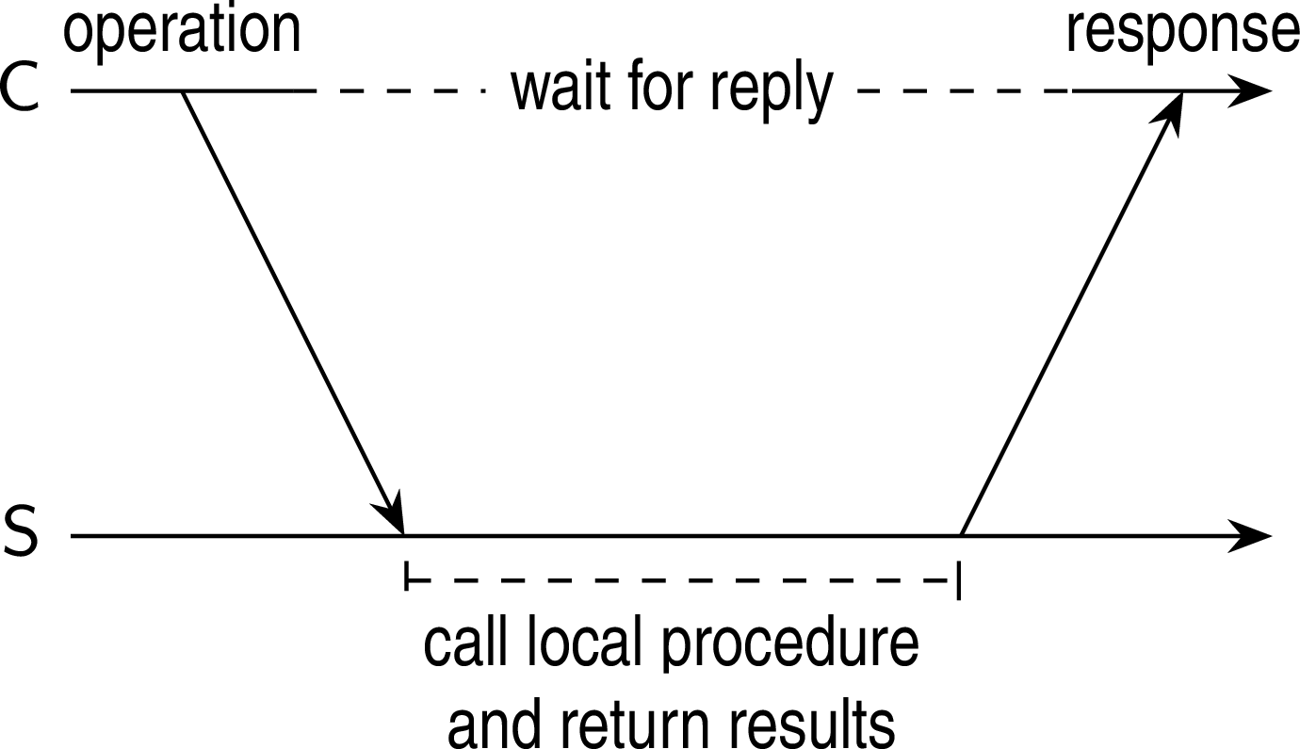
RPC between a client and server program.

Slide 13
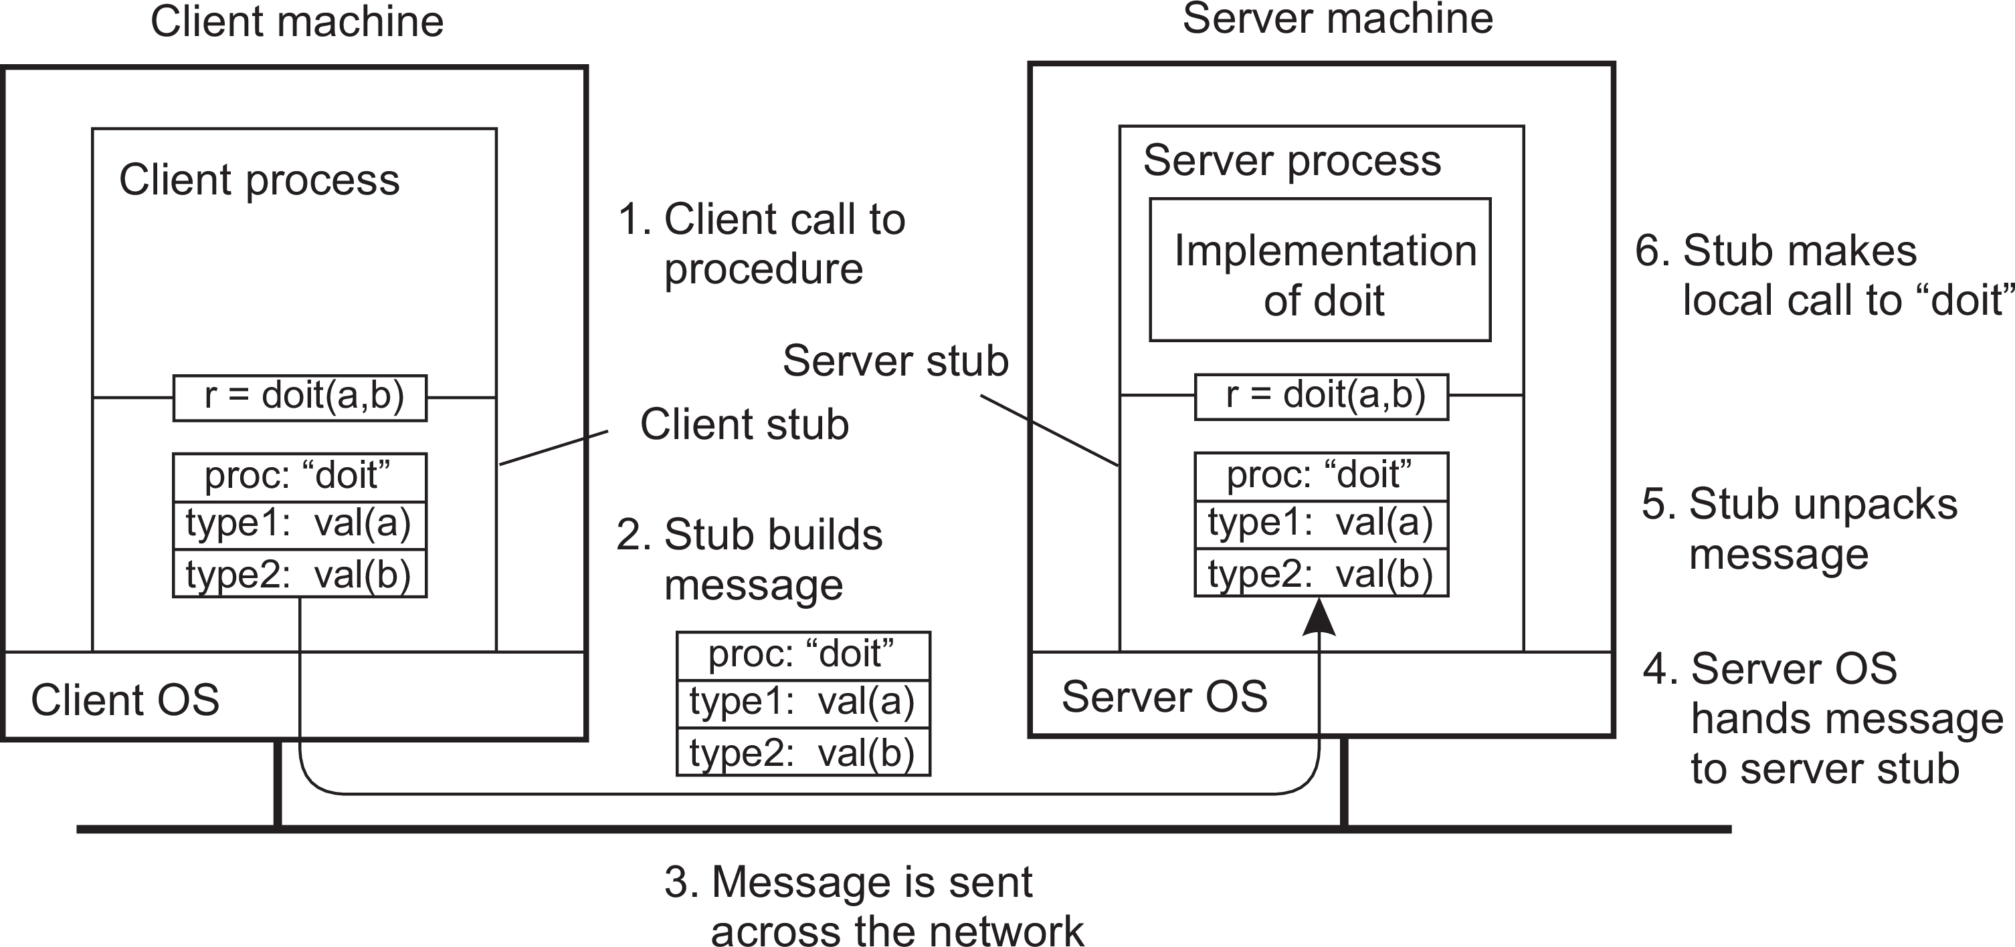
Basic RPC Operation
1. The client procedure calls the client stub in the normal way.

Slide 14
Basic RPC Operation
2. The client stub builds a message and calls the local operating system.

Slide 15
Basic RPC Operation
3. The client’s OS sends the message to the remote OS.

Slide 16
Basic RPC Operation
4. The remote OS gives the message to the server stub.

Slide 17
Basic RPC Operation
5. The server stub unpacks the parameter(s) and calls the server.

Slide 18
Basic RPC Operation
6. The server does the work and returns the result to the stub.

Slide 19
Basic RPC Operation
7. The server stub packs the result in a message and calls its local OS.

Slide 20
Basic RPC Operation
8. The server’s OS sends the message to the client’s OS.

Slide 21
Basic RPC Operation
9. The client’s OS gives the message to the client stub.

Slide 22
Basic RPC Operation
10. The stub unpacks the result and returns it to the client.

Slide 23
Variations on RPC
As in conventional procedure calls, when a client calls a remote procedure, the client will block until a reply is returned.
This strict request-reply behavior is unnecessary when there is no result to return, or may hinder efficiency when multiple RPCs need to be performed.

Slide 24
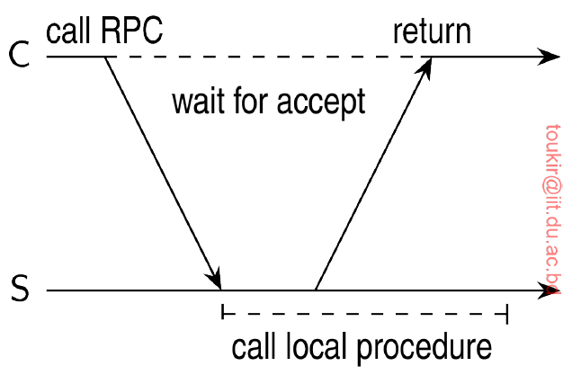
Asynchronous RPC

Slide 25
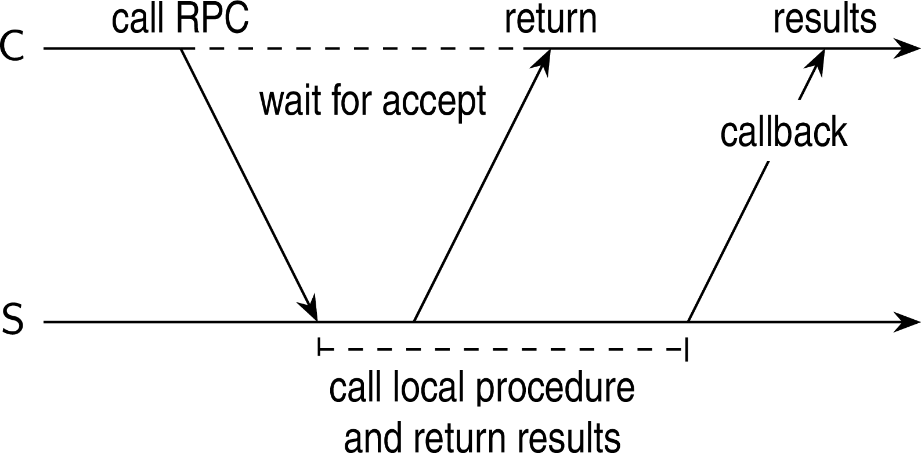
Deferred Synchronous RPC

